Slide 1

Winning the Space Race
With Data Science
Heath Barnett
October 16, 2023

Slide 2
Executive Summary
Introduction
Methodology
Results
Conclusion
Appendix
Outline

Slide 3
Summary of methodologies
Executive Summary
Summary of all results

Slide 4

Introduction
Predicting whether the Falcon 9 first stage will land successfully is a complex task that involves various factors, including:
Payload
Orbits
Booster Types
Geographical Information of Launch Sites
Success and Failure Rates
While SpaceX has made significant advancements in rocket reusability and has successfully landed many Falcon 9 first stages, there are still risks involved in each launch.
To make an accurate prediction of the success rate for future versions of Falcon 9, we will need to employ a variety of data science methodologies and machine learning techniques.

Slide 5
Section 1
Methodology

Slide 6
Data Collection

Slide 7
Data Collection – SpaceX API
Present your data collection with SpaceX REST calls using key phrases and flowcharts
Add the GitHub URL of the completed SpaceX API calls notebook (must include completed code cell and outcome cell), as an external reference and peer-review purpose
Place your flowchart of SpaceX API calls here

Slide 8
Data Collection - Scraping
Present your web scraping process using key phrases and flowcharts
Add the GitHub URL of the completed web scraping notebook, as an external reference and peer-review purpose

Slide 9
Data Wrangling
Describe how data were processed
You need to present your data wrangling process using key phrases and flowcharts
Add the GitHub URL of your completed data wrangling related notebooks, as an external reference and peer-review purpose

Slide 10

Exploratory Data Analysis with Data Visualization
Figure | Plot Type | Data
Figure 1 | Categorical | Flight Number vs Launch Site
Figure 2 | Categorical | Payload vs Launch Site
Figure 3 | Bar Chart | Success Rate vs Orbit
Figure 4 | Scatter | Flight Number vs Orbit
Figure 5 | Categorical | Payload vs Orbit
Figure 6 | Line | Annual Success Rate
Add the GitHub URL of your completed EDA with data visualization notebook, as an external reference and peer-review purpose

Slide 11
Exploratory Data Analysis with SQL
%%sql
SELECT Booster_Version as 'Booster', PAYLOAD_MASS__KG_ AS 'Payload Mass (kg)', Landing_Outcome AS 'Outcome'
FROM SPACEXTABLE
WHERE Landing_Outcome = 'Success (drone ship)'
AND PAYLOAD_MASS__KG_ BETWEEN '4000' AND '6000'
SQL Commands/Queries Used
SELECT
FROM
DISTINCT
WHERE
BETWEEN
LIKE
LIMIT
MIN
MAX
SUM
COUNT
%%sql
SELECT *
FROM SPACEXTABLE
WHERE Launch_Site
LIKE 'CCA%'
LIMIT 5
%%sql
SELECT Customer, SUM(PAYLOAD_MASS__KG_)
FROM SPACEXTABLE
WHERE Customer = 'NASA (CRS)'
Add the GitHub URL of your completed EDA with SQL notebook, as an external reference and peer-review purpose

Slide 12
Build an Interactive Map with Folium
Summarize what map objects such as markers, circles, lines, etc. you created and added to a folium map
Explain why you added those objects
Add the GitHub URL of your completed interactive map with Folium map, as an external reference and peer-review purpose

Slide 13
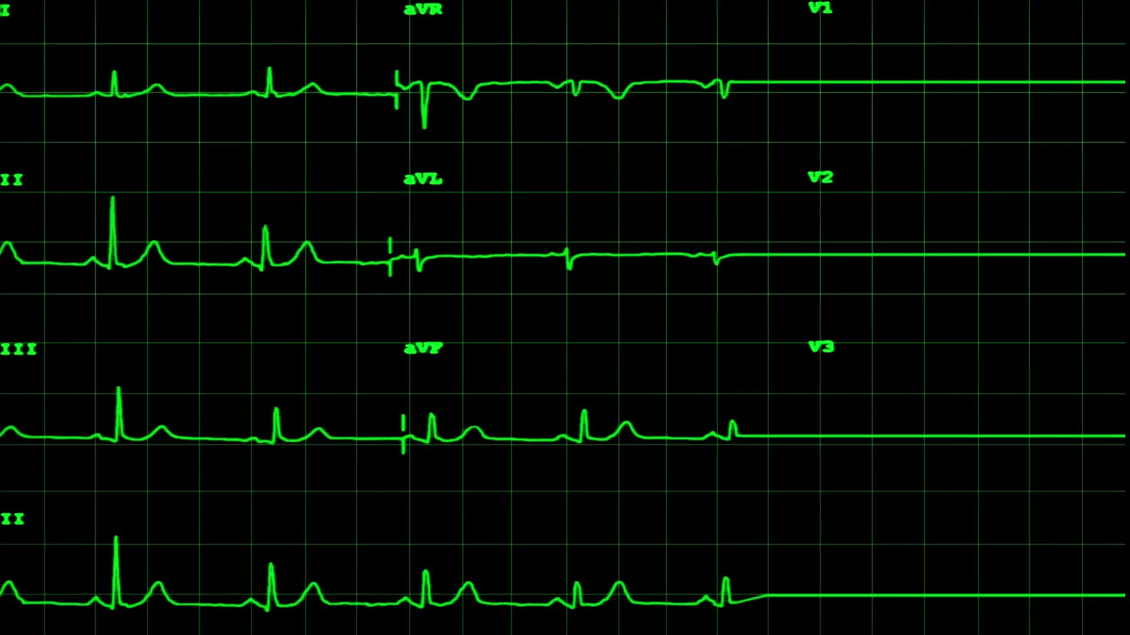
Summarize what plots/graphs and interactions you have added to a dashboard
Explain why you added those plots and interactions
Add the GitHub URL of your completed Plotly Dash lab, as an external reference and peer-review purpose
Build a Dashboard with Plotly Dash

Slide 14
Predictive Analysis (Classification)
Summarize how you built, evaluated, improved, and found the best performing classification model
You need present your model development process using key phrases and flowchart
Add the GitHub URL of your completed predictive analysis lab, as an external reference and peer-review purpose

Slide 15
Results
Exploratory data analysis results
Interactive analytics demo in screenshots
Predictive analysis results

Slide 16
Section 2
Insights from Exploratory Data Analysis

Slide 17
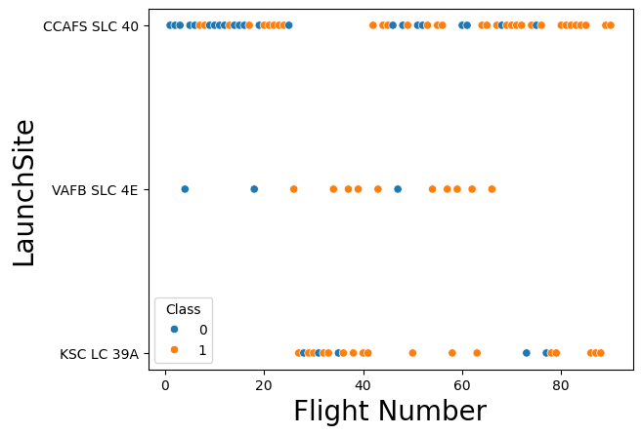
Flight Number vs. Launch Site
Data indicates that as flight numbers increase, the chance of success also increases.

Slide 18
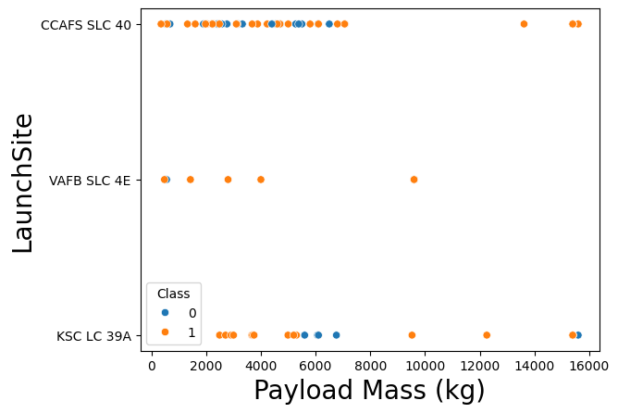
Payload vs. Launch Site
There is no clear relationship between payload mass and the launch site for CCAFS SLS 40 and KSC LC 39A.
Launch site VAFB SLC 4E does show consistent success rates regardless of payload.

Slide 19
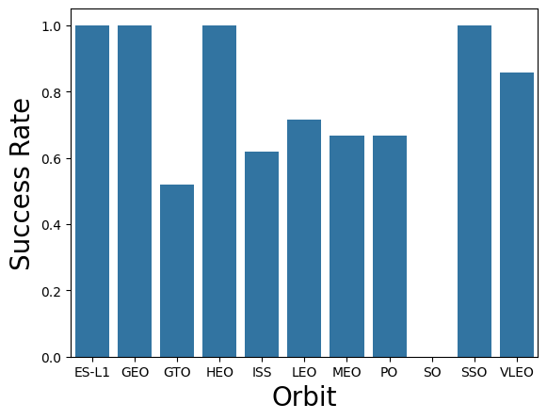
Success Rate vs. Orbit Type
Several orbit types have high success rates at or near 100%.
ES-L1, GEO, HEO, SSO and VLEO
SO orbit always fails.

Slide 20
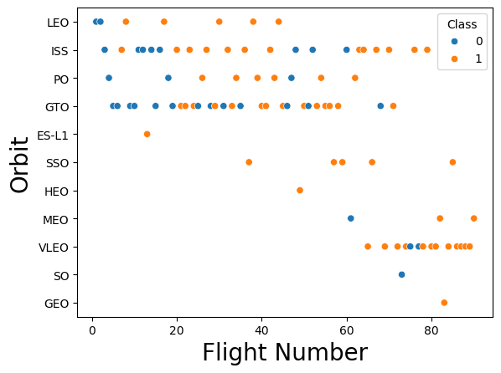
Flight Number vs. Orbit Type
Early flight numbers are more likely to fail regardless of orbit. Consistent with previous findings regarding flight numbers and launch sites.
Some orbit types are not attempted until much later in development cycle.

Slide 21
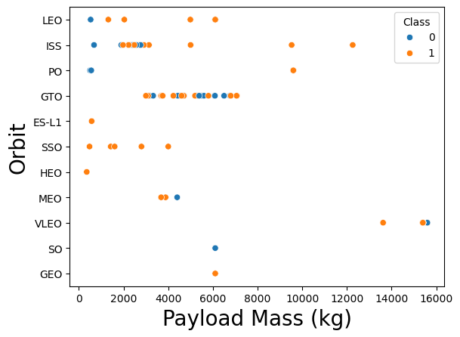
Payload vs. Orbit Type
With heavy payloads the successful landing or positive landing rate are more for Polar,LEO and ISS.
GTO is inconclusive, positive landing rate and negative landing(unsuccessful mission) are both relatively equal in the payload range of 3500 to 7000.

Slide 22
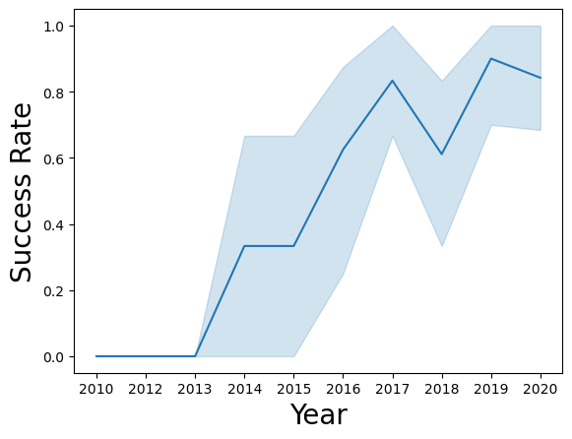
Launch Success Yearly Trend
Launch success on a steady increase from 2013 and 2017.
2018 show a downturn but the following year success rates rebounded.

Slide 23
All Launch Site Names
Launch_Site
CCAFS LC-40
VAFB SLC-4E
KSC LC-39A
CCAFS SLC-40
%%sql
SELECT DISTINCT Launch_Site
FROM SPACEXTABLE

Slide 24
Launch Site Names Begin with 'CCA'
%%sql
SELECT *
FROM SPACEXTABLE
WHERE Launch_Site
LIKE 'CCA%'
LIMIT 5
Date | Time (UTC) | Booster_Version | Launch_Site | Payload | PAYLOAD_MASS__KG_ | Orbit | Customer | Mission_Outcome | Landing_Outcome
2010-04-06 | 18:45:00 | F9 v1.0 B0003 | CCAFS LC-40 | Dragon Spacecraft Qualification Unit | 0 | LEO | SpaceX | Success | Failure (parachute)
2010-08-12 | 15:43:00 | F9 v1.0 B0004 | CCAFS LC-40 | Dragon demo flight C1, two CubeSats, barrel of Brouere cheese | 0 | LEO (ISS) | NASA (COTS) NRO | Success | Failure (parachute)
2012-05-22 | 07:44:00 | F9 v1.0 B0005 | CCAFS LC-40 | Dragon demo flight C2 | 525 | LEO (ISS) | NASA (COTS) | Success | No attempt
2012-08-10 | 00:35:00 | F9 v1.0 B0006 | CCAFS LC-40 | SpaceX CRS-1 | 500 | LEO (ISS) | NASA (CRS) | Success | No attempt
2013-01-03 | 15:10:00 | F9 v1.0 B0007 | CCAFS LC-40 | SpaceX CRS-2 | 677 | LEO (ISS) | NASA (CRS) | Success | No attempt

Slide 25

Total Payload Mass
%%sql
SELECT Customer, SUM(PAYLOAD_MASS__KG_)
FROM SPACEXTABLE
WHERE Customer = 'NASA (CRS)'
Customer | SUM(PAYLOAD_MASS__KG_)
NASA (CRS) | 45596

Slide 26

Average Payload Mass by F9 v1.1
%%sql
SELECT Booster_Version, AVG(PAYLOAD_MASS__KG_) AS 'Average Payload'
FROM SPACEXTABLE
WHERE Booster_Version = 'F9 v1.1'
Booster_Version | Average Payload
F9 v1.1 | 2928.4

Slide 27

First Successful Ground Landing Date
%%sql
SELECT min(Date) as 'Date of First Ground Pad Success'
FROM SPACEXTABLE
WHERE Landing_Outcome = 'Success (ground pad)'
Date of First Ground Pad Success
2015-12-22

Slide 28
Successful Drone Ship Landing with
Payload between 4000 and 6000
%%sql
SELECT Booster_Version as 'Booster', PAYLOAD_MASS__KG_ AS 'Payload Mass (kg)', Landing_Outcome AS 'Outcome'
FROM SPACEXTABLE
WHERE Landing_Outcome = 'Success (drone ship)'
AND PAYLOAD_MASS__KG_ BETWEEN '4000' AND '6000'
Booster | Payload Mass (kg) | Outcome
F9 FT B1022 | 4696 | Success (drone ship)
F9 FT B1026 | 4600 | Success (drone ship)
F9 FT B1021.2 | 5300 | Success (drone ship)
F9 FT B1031.2 | 5200 | Success (drone ship)

Slide 29
Total Number of Successful and Failure
Mission Outcomes
%%sql
SELECT Mission_Outcome, count(*) as 'Count'
FROM SPACEXTABLE
GROUP BY Mission_Outcome
Mission_Outcome | Count
Failure (in flight) | 1
Success | 98
Success | 1
Success (payload status unclear) | 1

Slide 30
Boosters Carried Maximum Payload
Booster | Max Payload
F9 B5 B1048.4 | 15600
F9 B5 B1049.4 | 15600
F9 B5 B1051.3 | 15600
F9 B5 B1056.4 | 15600
F9 B5 B1048.5 | 15600
F9 B5 B1051.4 | 15600
F9 B5 B1049.5 | 15600
F9 B5 B1060.2 | 15600
F9 B5 B1058.3 | 15600
F9 B5 B1051.6 | 15600
F9 B5 B1060.3 | 15600
F9 B5 B1049.7 | 15600
%%sql
SELECT Booster_Version as 'Booster', PAYLOAD_MASS__KG_ AS 'Max Payload'
FROM SPACEXTABLE
WHERE PAYLOAD_MASS__KG_ = (SELECT MAX(PAYLOAD_MASS__KG_) FROM SPACEXTABLE)

Slide 31
2015 Launch Records
%%sql
SELECT
CASE substr(Date,6,2)
WHEN '01' THEN 'January'
WHEN '02' THEN 'Febuary'
WHEN '03' THEN 'March'
WHEN '04' THEN 'April'
WHEN '05' THEN 'May'
WHEN '06' THEN 'June'
WHEN '07' THEN 'July'
WHEN '08' THEN 'August'
WHEN '09' THEN 'September'
WHEN '10' THEN 'October'
WHEN '11' THEN 'November'
WHEN '12' THEN 'December'
ELSE ''
END AS Month, Landing_Outcome, Booster_Version, Launch_Site
FROM SPACEXTABLE
WHERE Landing_Outcome = 'Failure (drone ship)'
AND SUBSTR(Date,0,5)='2015'
Month | Landing_Outcome | Booster_Version | Launch_Site
October | Failure (drone ship) | F9 v1.1 B1012 | CCAFS LC-40
April | Failure (drone ship) | F9 v1.1 B1015 | CCAFS LC-40

Slide 32
Rank Landing Outcomes Between 2010-06-04 and 2017-03-20
%%sql
SELECT Landing_Outcome, count(Landing_Outcome) AS 'Total', Date
FROM SPACEXTABLE
WHERE Date BETWEEN '2010-06-04' AND '2017-03-20'
GROUP BY Landing_Outcome
ORDER BY count(Landing_Outcome) DESC
Landing_Outcome | Total | Date
No attempt | 10 | 2012-05-22
Success (ground pad) | 5 | 2015-12-22
Success (drone ship) | 5 | 2016-08-04
Failure (drone ship) | 5 | 2015-10-01
Controlled (ocean) | 3 | 2014-04-18
Uncontrolled (ocean) | 2 | 2013-09-29
Precluded (drone ship) | 1 | 2015-06-28
Failure (parachute) | 1 | 2010-08-12

Slide 33
Section 3
Launch Site Proximities Analysis

Slide 34
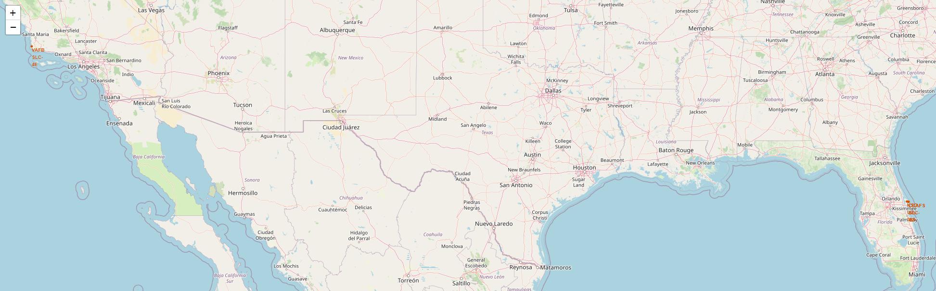
All Launch Sites
Located on coast areas, both southwest and southeast United States.

Slide 35
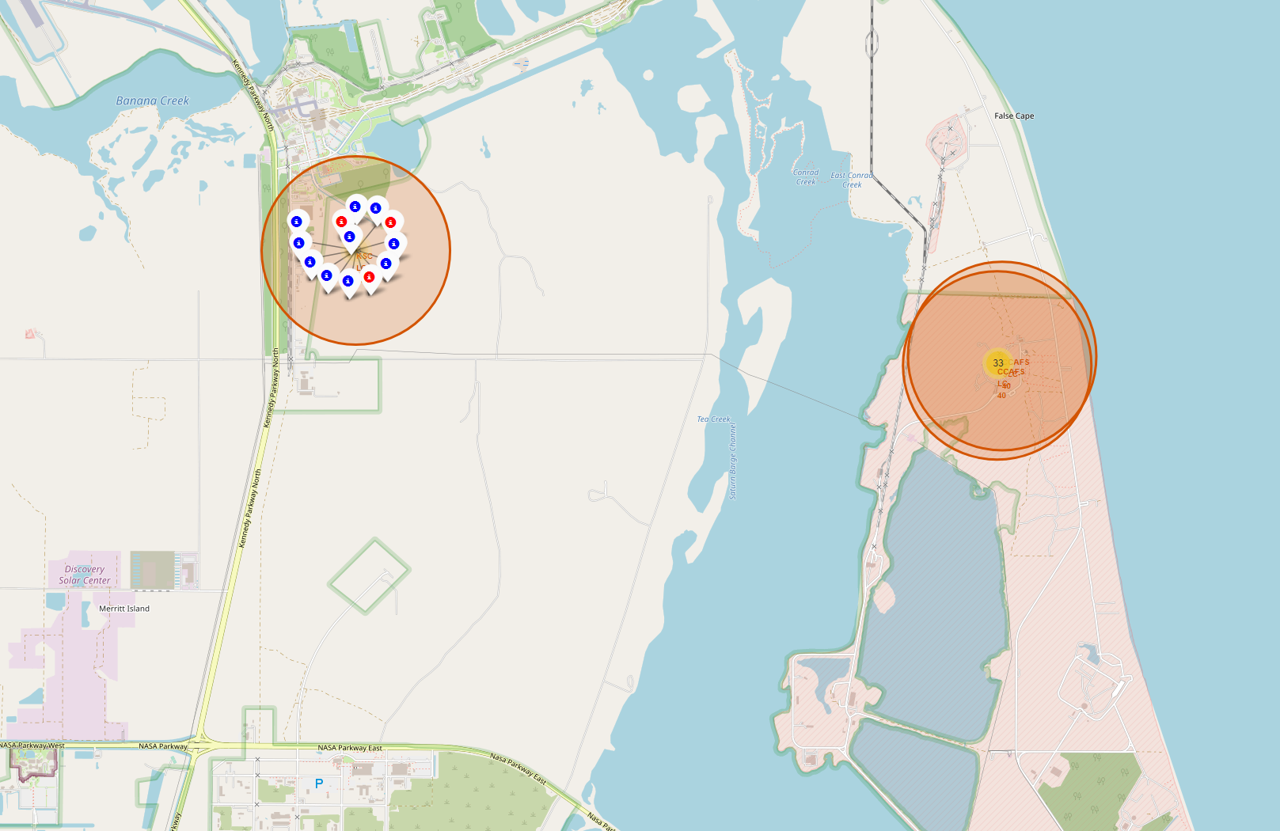
Launch Site Outcomes at KSC LC-39A
Blue indicates a successful launch, red indicates a failure.
Located in Florida, southeast coast.

Slide 36
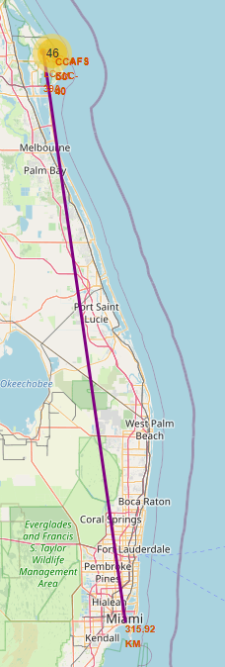
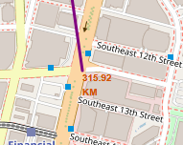
Launch Site KSC LC-39A Distance to Miami Florida
def calculate_distance(lat1, lon1, lat2, lon2):
# approximate radius of earth in km
R = 6373.0
lat1 = radians(lat1)
lon1 = radians(lon1)
lat2 = radians(lat2)
lon2 = radians(lon2)
dlon = lon2 - lon1
dlat = lat2 - lat1
a = sin(dlat / 2)**2 + cos(lat1) * cos(lat2) * sin(dlon / 2)**2
c = 2 * atan2(sqrt(a), sqrt(1 - a))
distance = R * c
return distance
launch_site_lat, launch_site_lon, city_lat, city_lon = 28.57299, -80.64621,25.761681,-80.191788
distance_city = calculate_distance(launch_site_lat, launch_site_lon, city_lat, city_lon)
distance_city
Distance of 315.92 km.

Slide 37
Section 4
Build a Dashboard with Plotly Dash

Slide 38
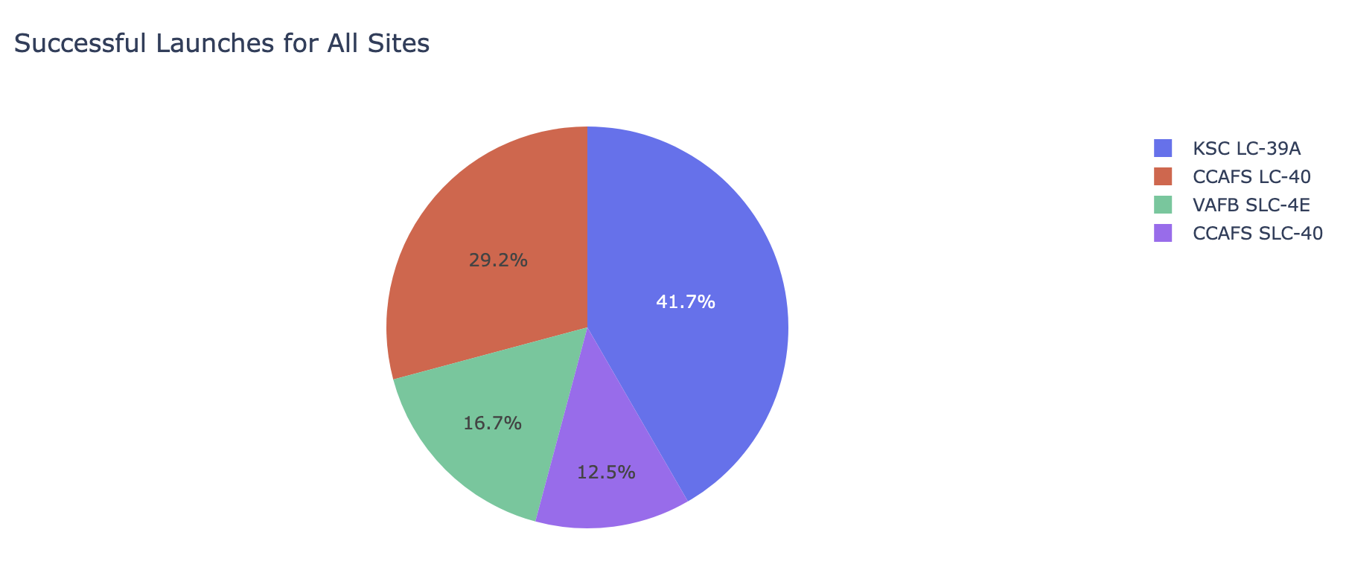
Launch Outcome
for all Sites
Launch Outcome for All Sites
KSC LC-39A has the highest success rate compared to all other launch sites.
CCAFS SLC-40 has the worst success of all launch sites.

Slide 39
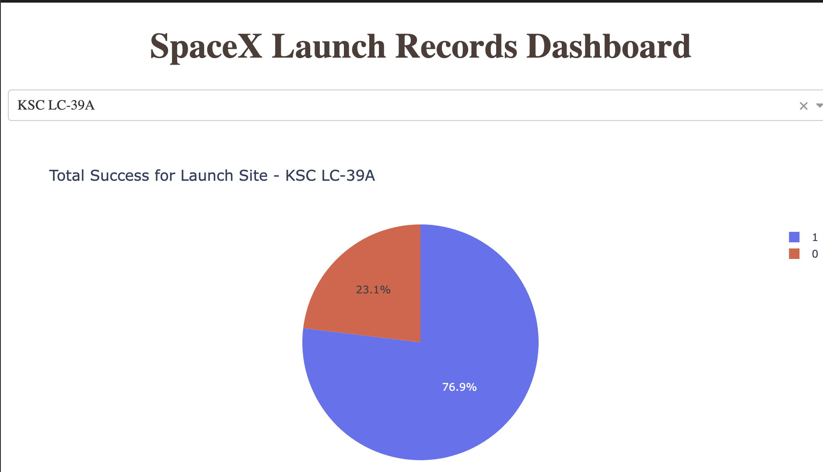
Launch Site with Highest Success Rate
Launch site KSC LC-39A had the highest success rate out of all landing sites with a 76.9% success rate.
The success/failure rate at this site is represented with a pie chart.

Slide 40
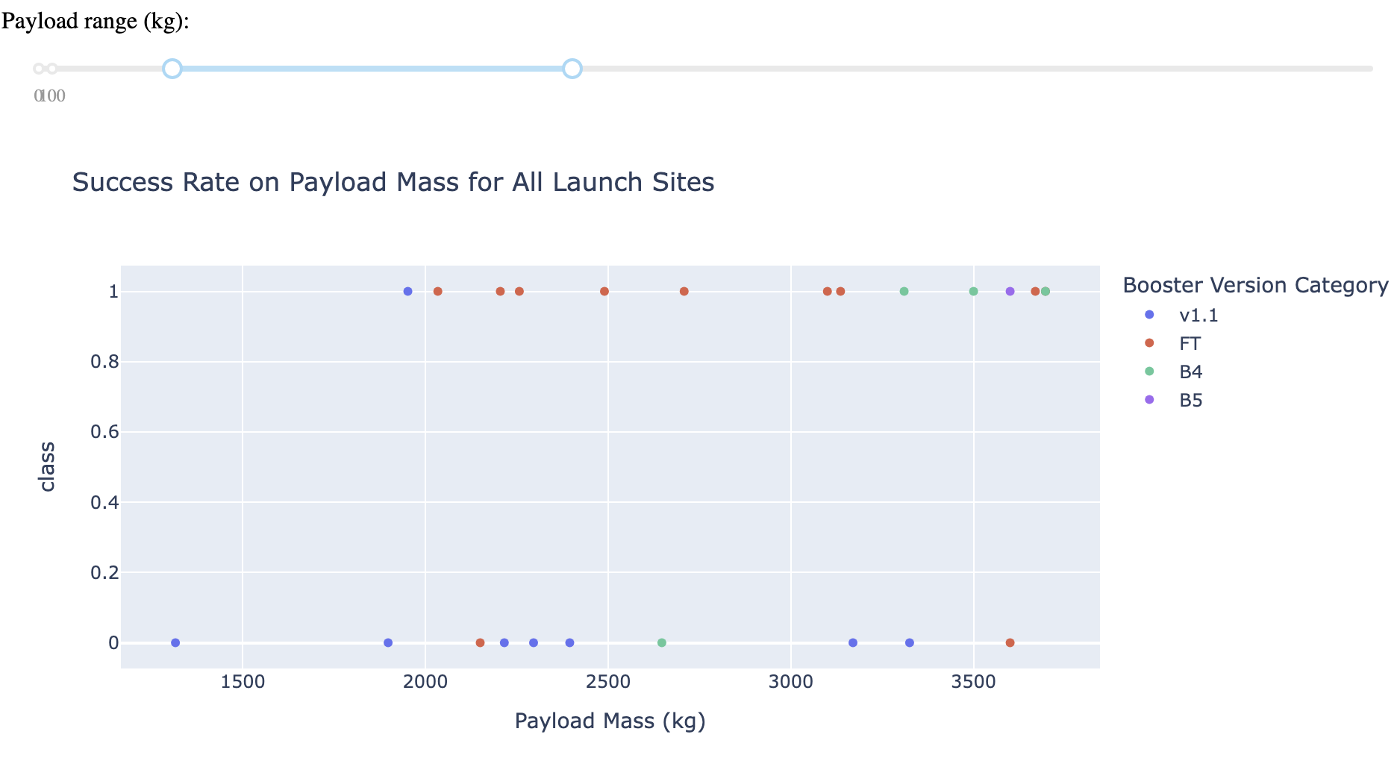
Payload vs. Launch Outcome
Payload vs Launch Outcome for All Sites
The FT booster version has the highest success rate compared to all other boosters in the payload range of 1000-4000 kg.

Slide 41
Section 5
Predictive Analysis (Classification)

Slide 42
Visualize the built model accuracy for all built classification models, in a bar chart
Find which model has the highest classification accuracy
Classification Accuracy

Slide 43

Confusion Matrix
Decision Tree Classifier
Decision Tree Classifier performed the best on training data with an accuracy of 87.7%.
The model did not predict outcomes any better than other models investigated.
False negatives are an issue with this model.

Slide 44
Conclusions
Point 1
Point 2
Point 3
Point 4
…

Slide 45

Thank You!

